Slide 1
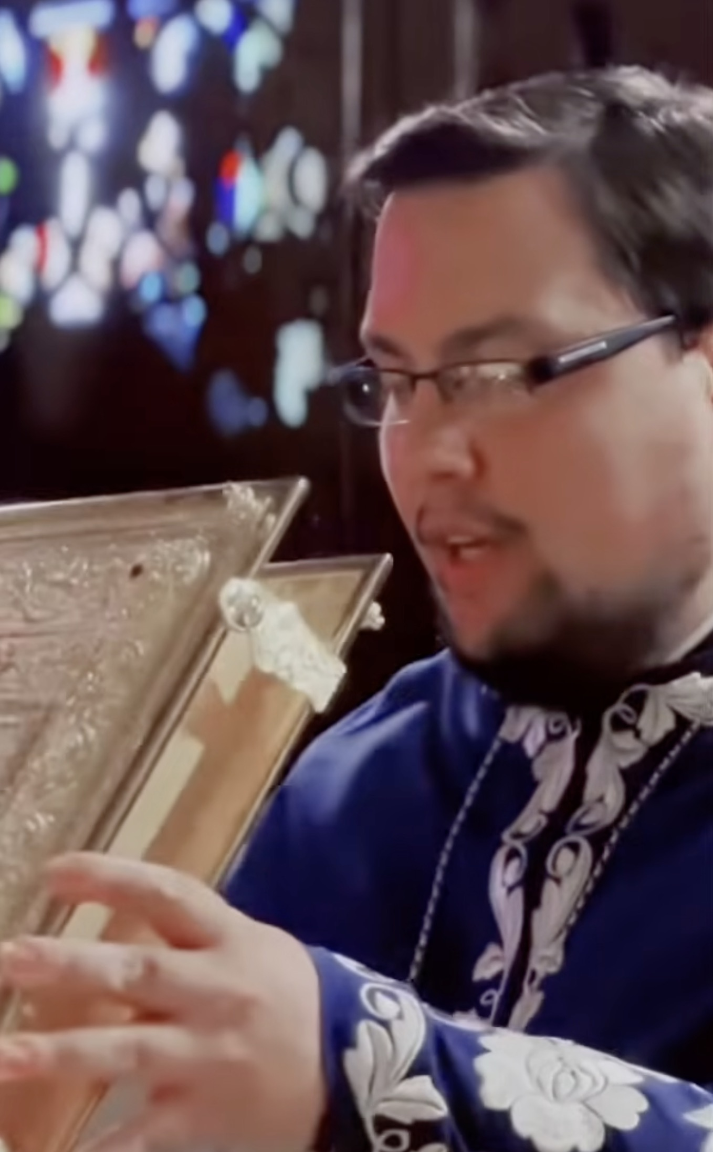
UNDERSTANDING THE DIVINE LITURGY
The Church Gathers:
“Blessed Is the Kingdom”
“Where the bishop appears, there let the people be; as wherever Jesus Christ is, there is the catholic Church.” - St. Ignatius of Antioch
“Blessed is the Kingdom of the Father, and of the Son, and of the Holy Spirit, now and ever and unto ages of ages.”
Tonight: who serves the Liturgy, why a hierarchical Liturgy looks different, and what the opening prayers are teaching us.

Slide 2
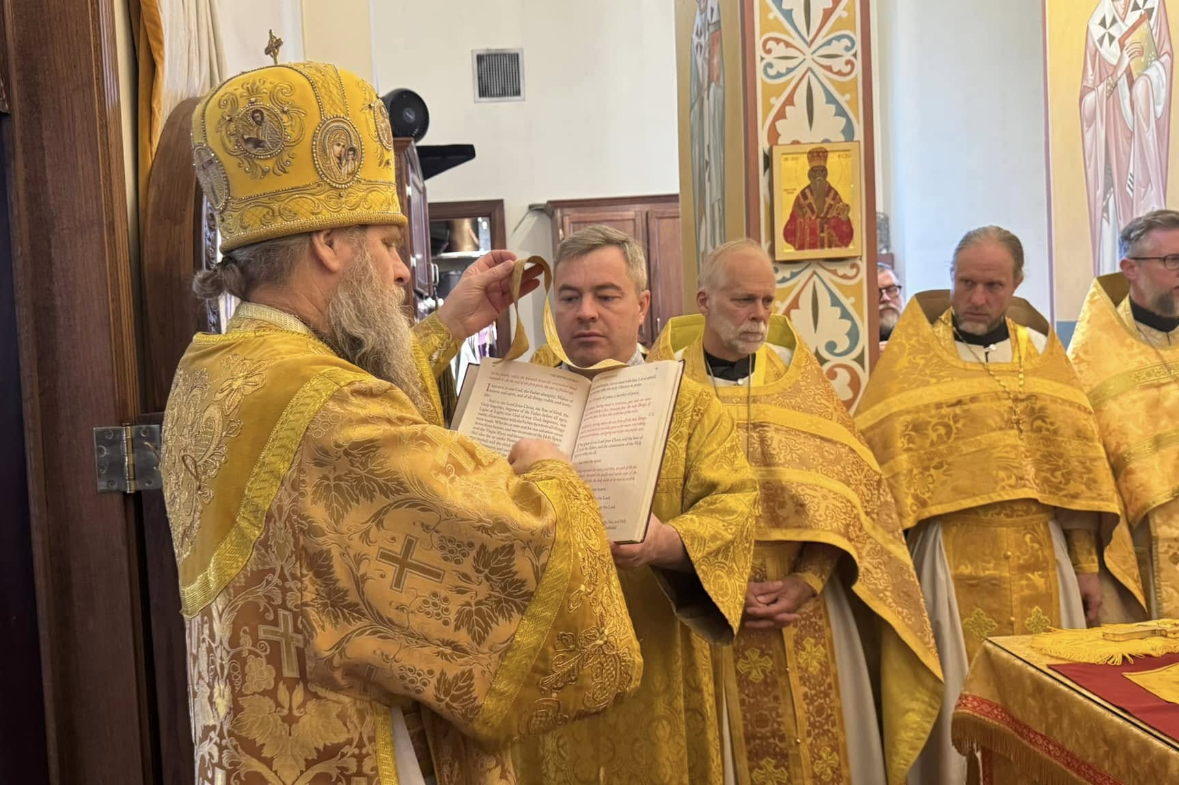
A QUESTION TO BEGIN
Why does the Liturgy look different when the bishop is present?
The answer is built into the structure of the Liturgy itself.

Slide 3
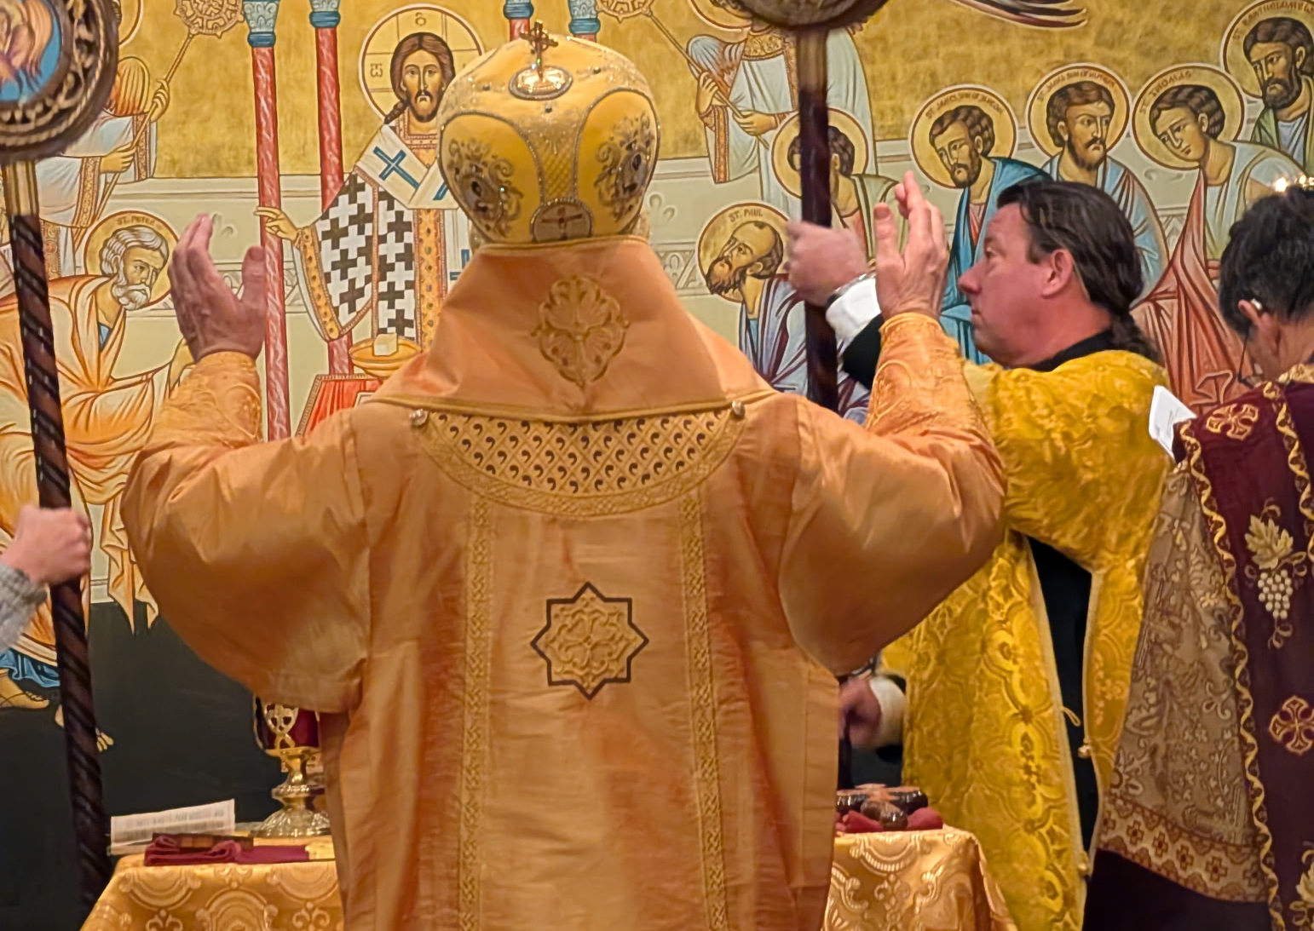
DIVINE LITURGY • CLASS 2
The Liturgy Assumes the Full Church Is Present
Same Divine Liturgy.
Different appearance.
Why?
Bishop → Priest → Deacon → Subdeacon → Reader → Choir & Faithful

Slide 4
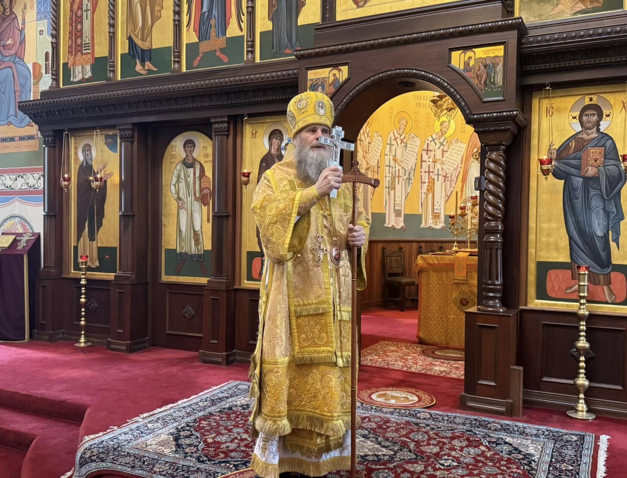
DIVINE LITURGY • CLASS 2
The Bishop
The Eucharistic assembly gathers around the bishop.
The priest serves with his blessing.
Every parish remains connected to its bishop.

Slide 5
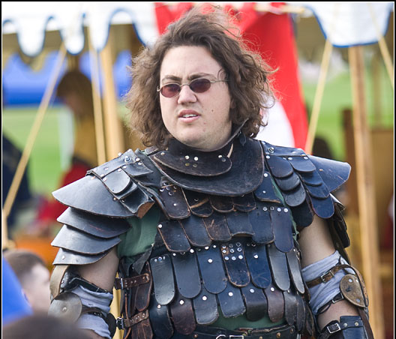
DIVINE LITURGY • CLASS 2
The Priest - What is he doing?
Fighting online chuds and Orthobros
Wielding his mighty axe
Defending the Faith in Facebook comment sections
Correcting people who learned Orthodoxy from YouTube last Tuesday

Slide 6
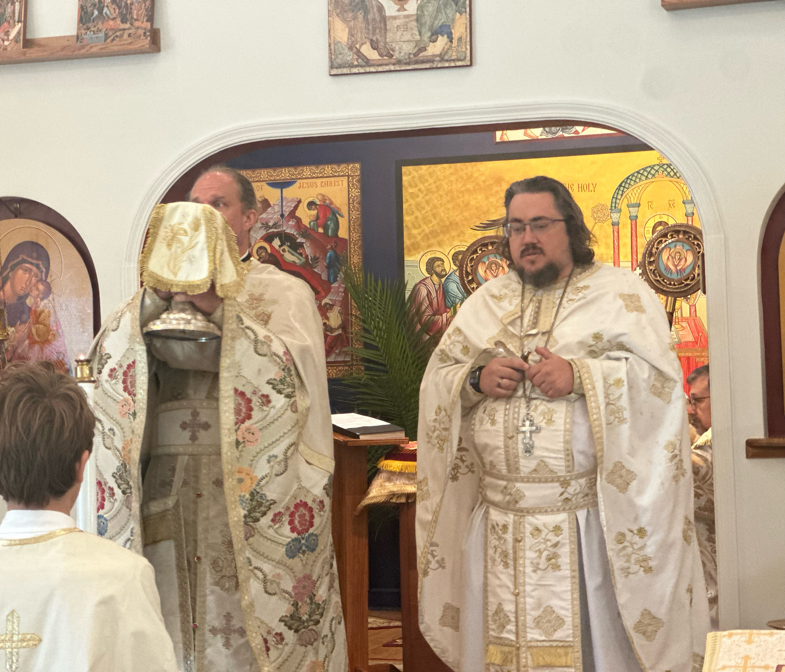
DIVINE LITURGY • CLASS 2
The Priest - For Real
Presides when the bishop is absent.
Offers the Eucharistic prayers.
Serves with the bishop’s blessing.
Supplies other necessary roles when ministers are absent.

Slide 7
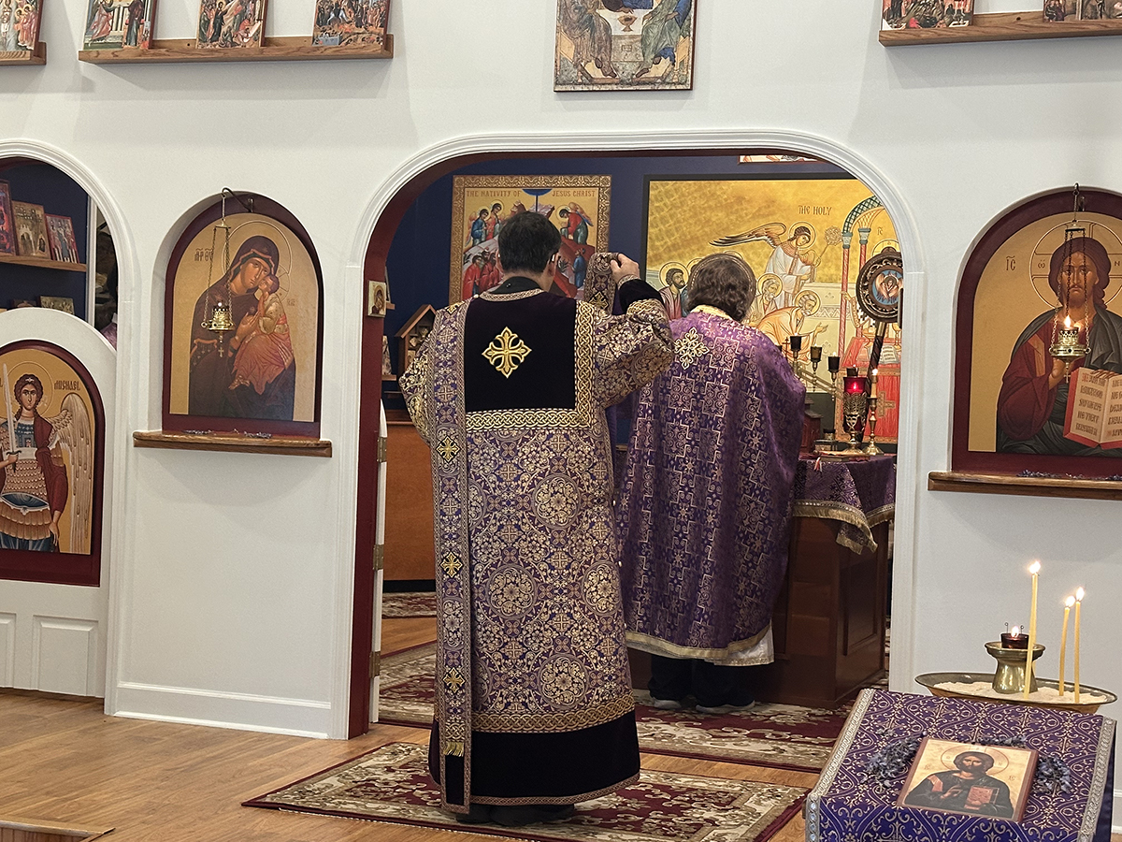
DIVINE LITURGY • CLASS 2
The Deacon - “In Peace Let Us Pray to the Lord”
Leads the litanies
Calls the people to prayer
Proclaims the Gospel
Censes
Assists in processions
Directs liturgical movement

Slide 8
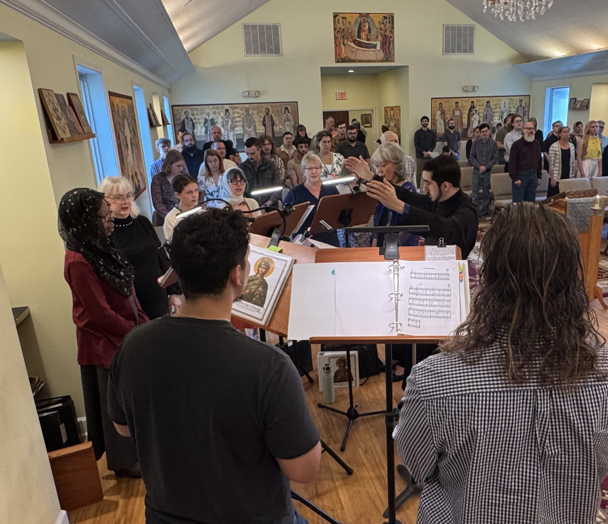
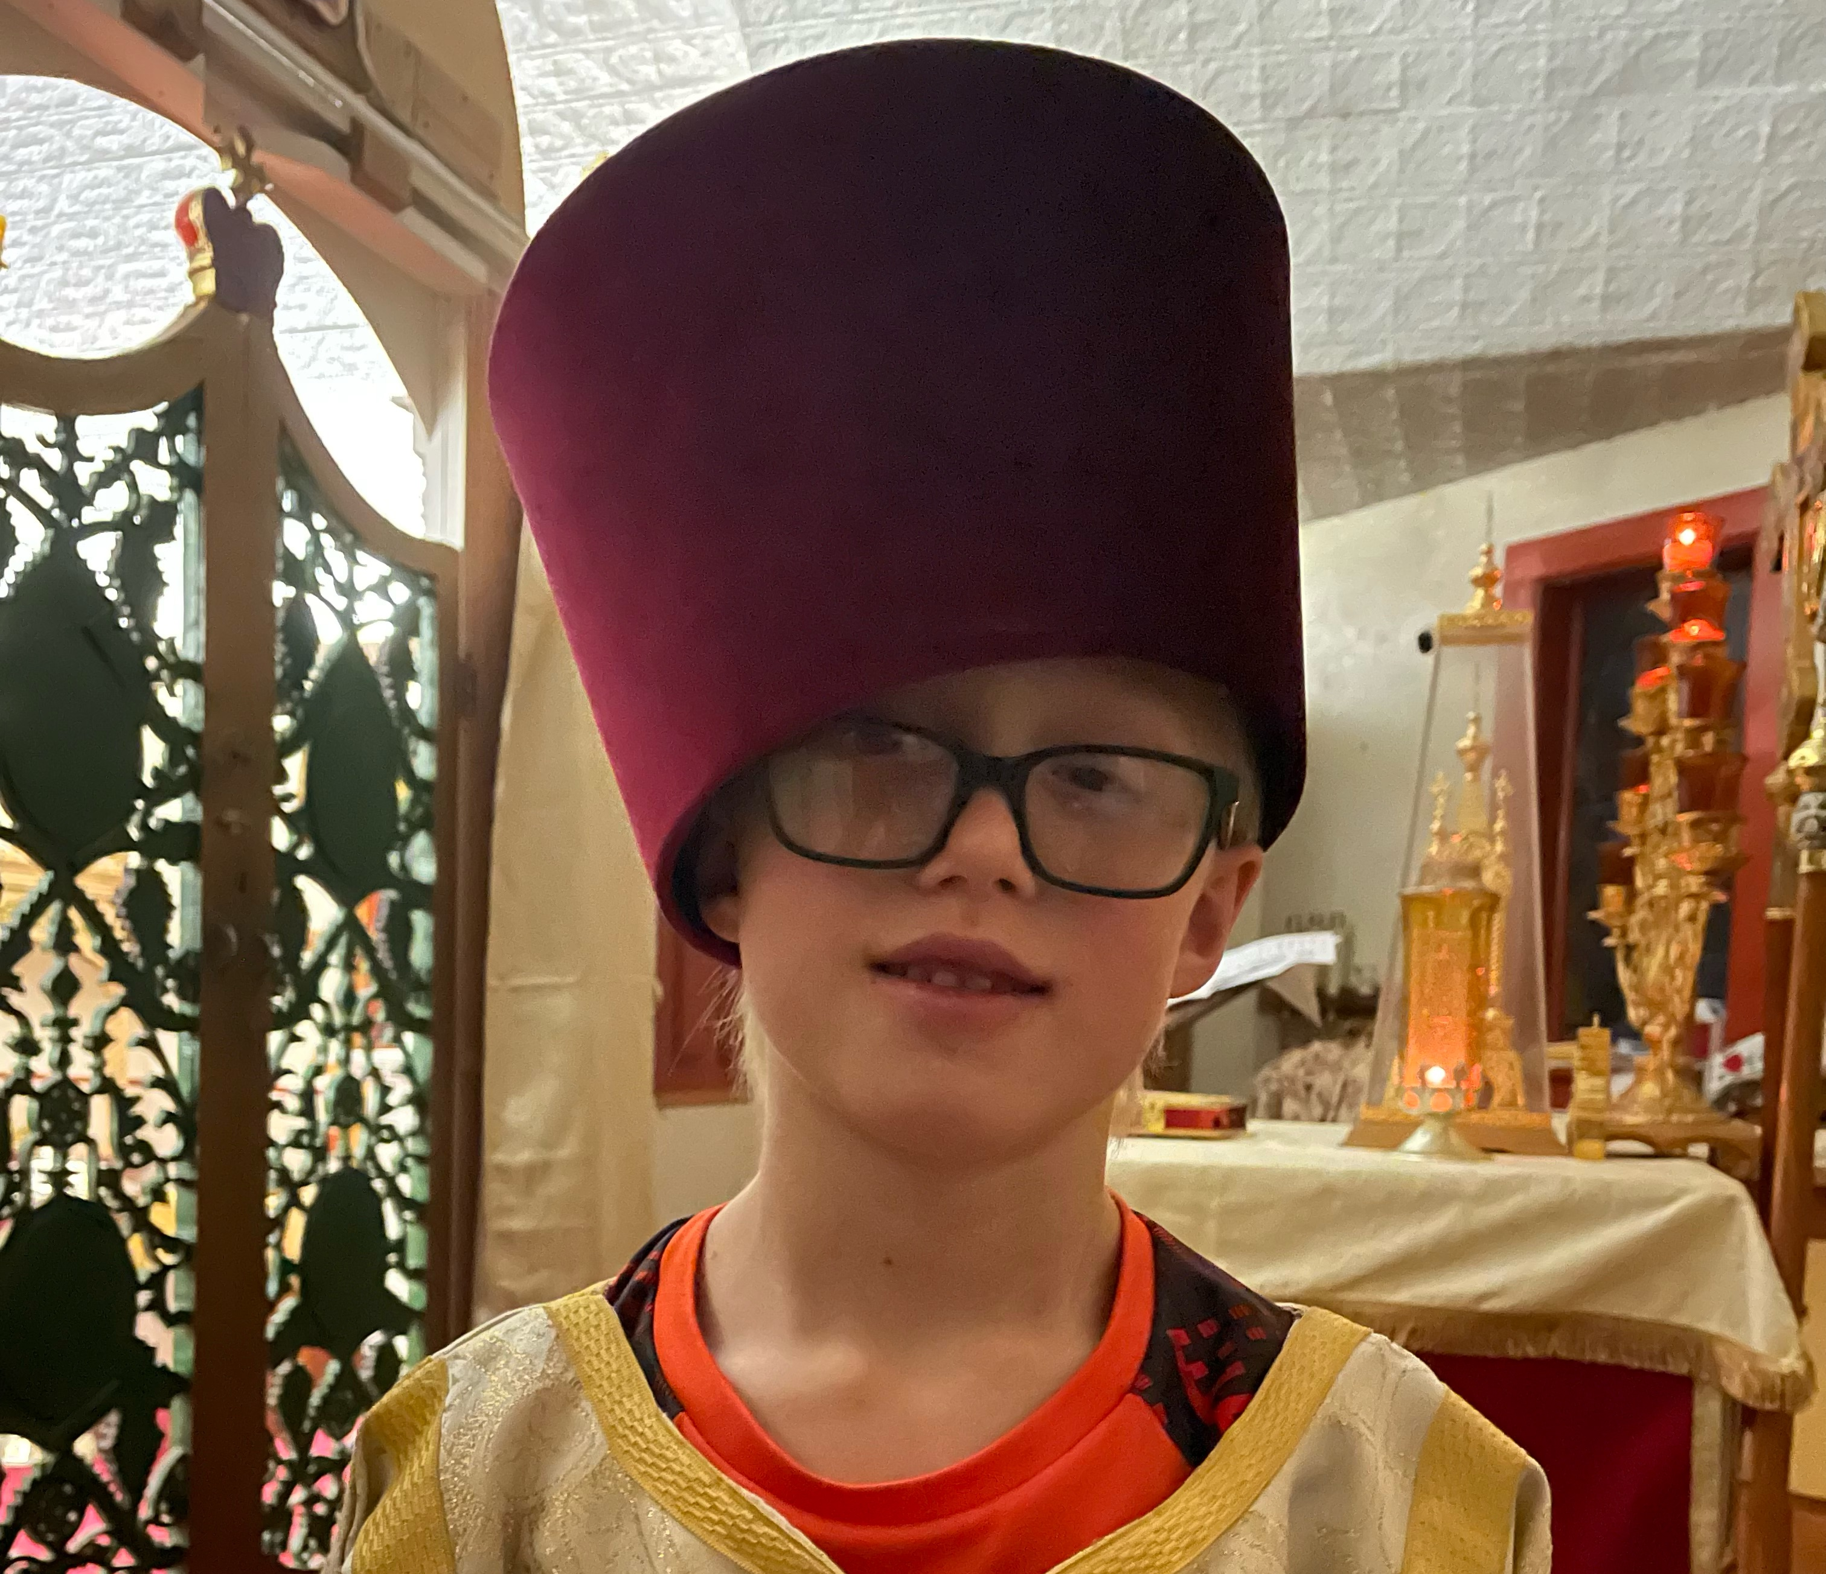
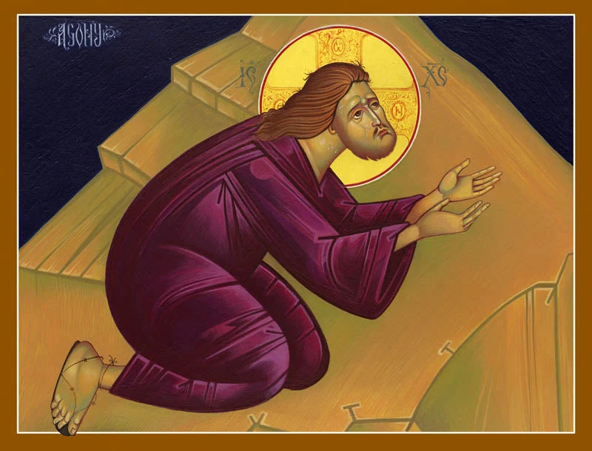
DIVINE LITURGY • CLASS 2
The Other Liturgical Ministries - Everyone Has a Place
Subdeacon → Reader → Altar Server → Choir & Faithful

Slide 9
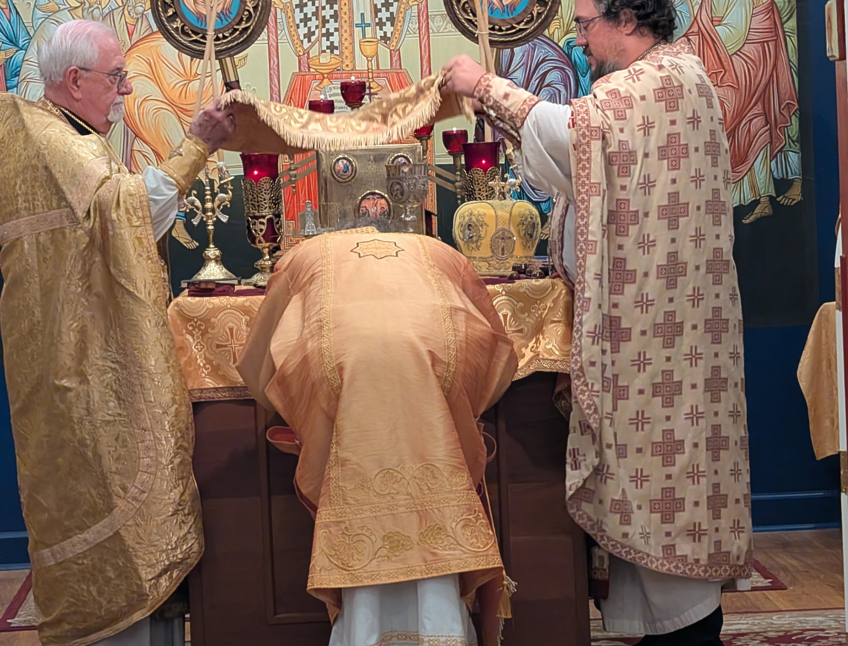
DIVINE LITURGY • CLASS 2
Why the Hierarchical Liturgy Looks Different
A hierarchical Liturgy is not a different Divine Liturgy.
When the bishop comes, he isn’t adding a bunch of pomp to make himself important.
You’re seeing the structure that is normally compressed become visible.

Slide 10
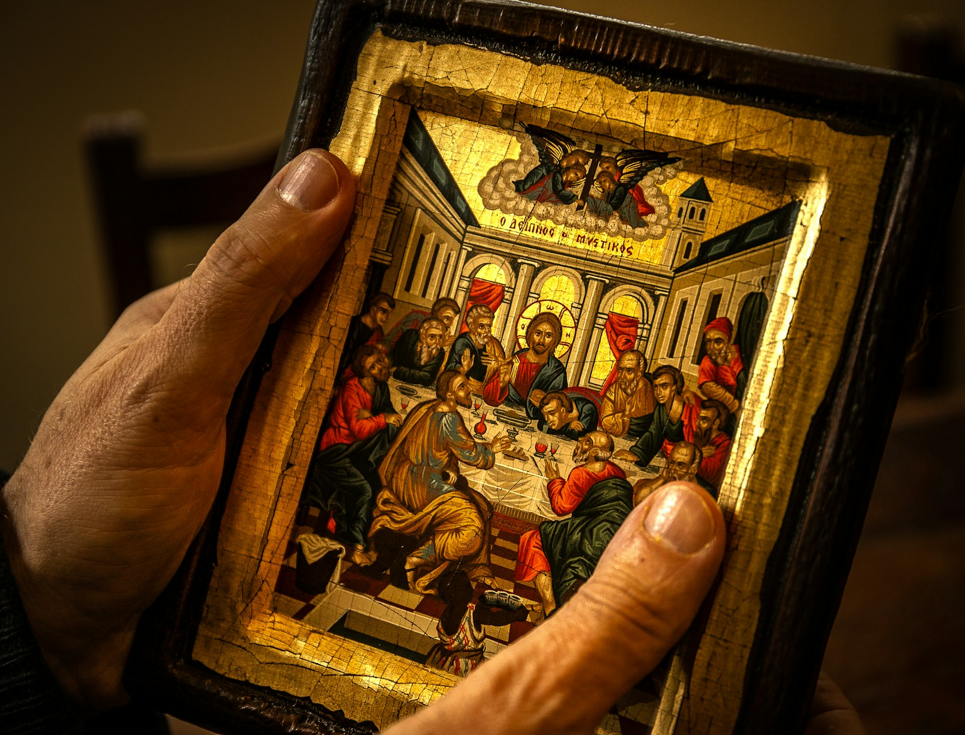
DIVINE LITURGY • CLASS 2
Who is the center of the Liturgy?
Not the bishop.
Not the priest.
Not the choir.
Not you.
CHRIST.

Slide 11
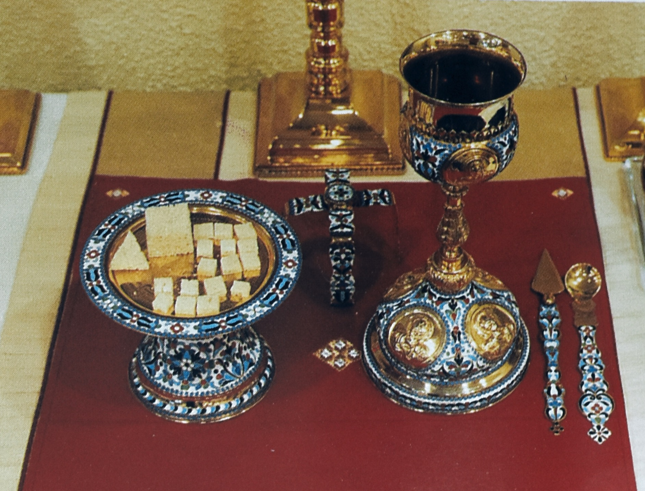
DIVINE LITURGY • CLASS 2
Before the Public Liturgy Begins
The Gifts have been prepared.
The Lamb has been cut.
The living and departed have been commemorated.
The Church has been gathered around Christ on the diskos.

Slide 12
DIVINE LITURGY • CLASS 2
The First Public Words
NOW THE LITURGY ACTUALLY BEGINS
“Blessed is the Kingdom of the Father, and of the Son, and of the Holy Spirit, now and ever and unto ages of ages.”
AMEN.

Slide 13
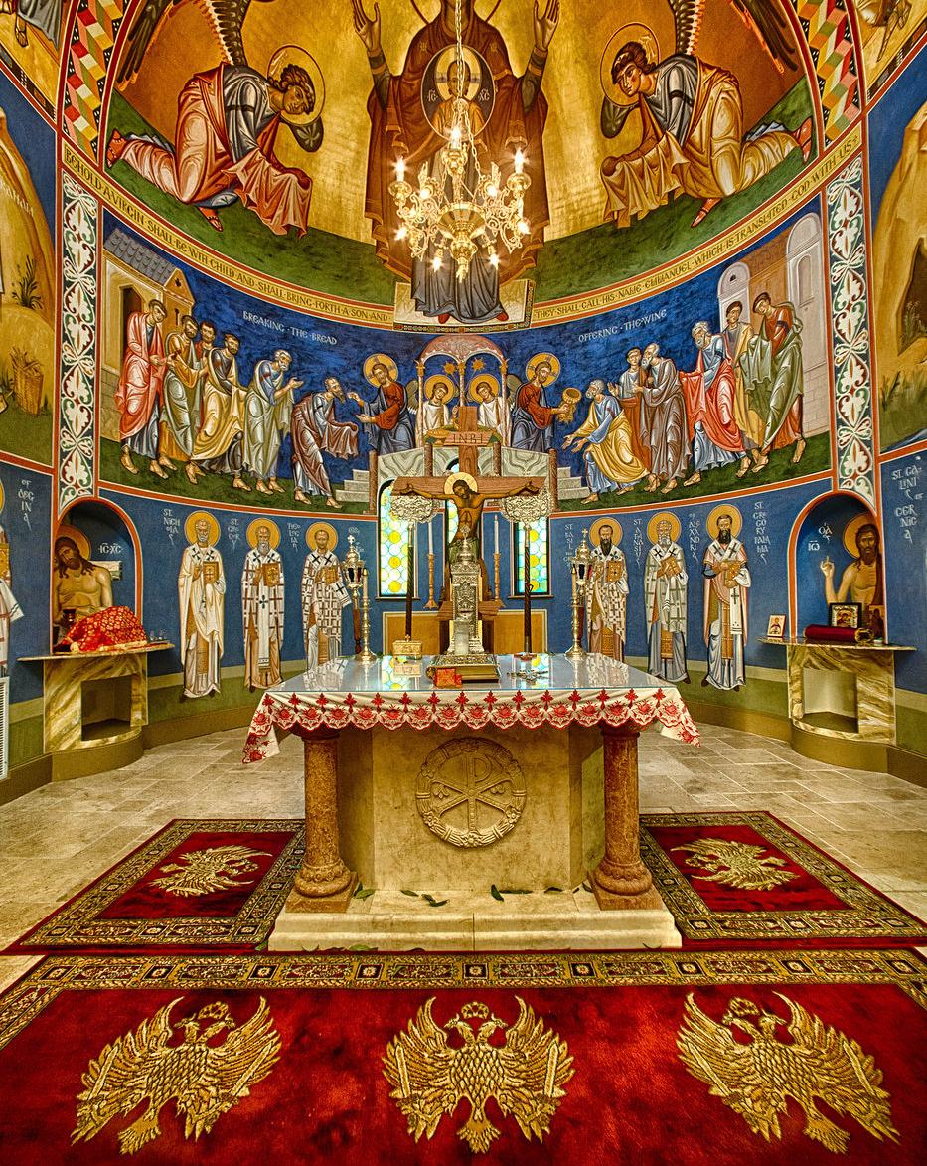
What Kingdom?
The Kingdom of God
Not merely somewhere we go when we die.
Christ announces: “The Kingdom of heaven is at hand.” Matthew 4:17
DIVINE LITURGY • CLASS 2

Slide 14
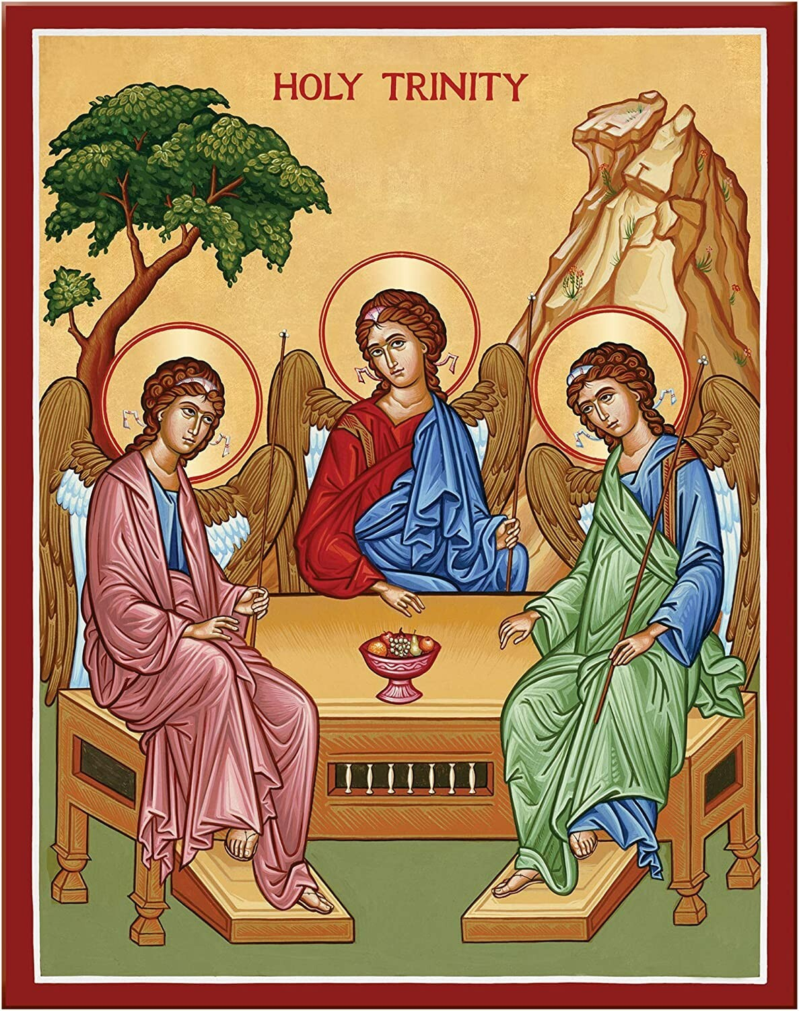
Why the Opening Is Trinitarian
Father • Son • Holy Spirit
Christian worship is worship of the Holy Trinity.
The entire Liturgy unfolds within the life of the Trinity.
We begin by blessing the Kingdom because communion with the Triune God is the end for which we were created.
DIVINE LITURGY • CLASS 2

Slide 15
DIVINE LITURGY • CLASS 2
“In Peace Let Us Pray to the Lord”
In peace: What peace?
Let us: Not “Father is going to pray now.” The entire Church is being summoned.
Pray: Before we do anything else, the Church prays.

Slide 16
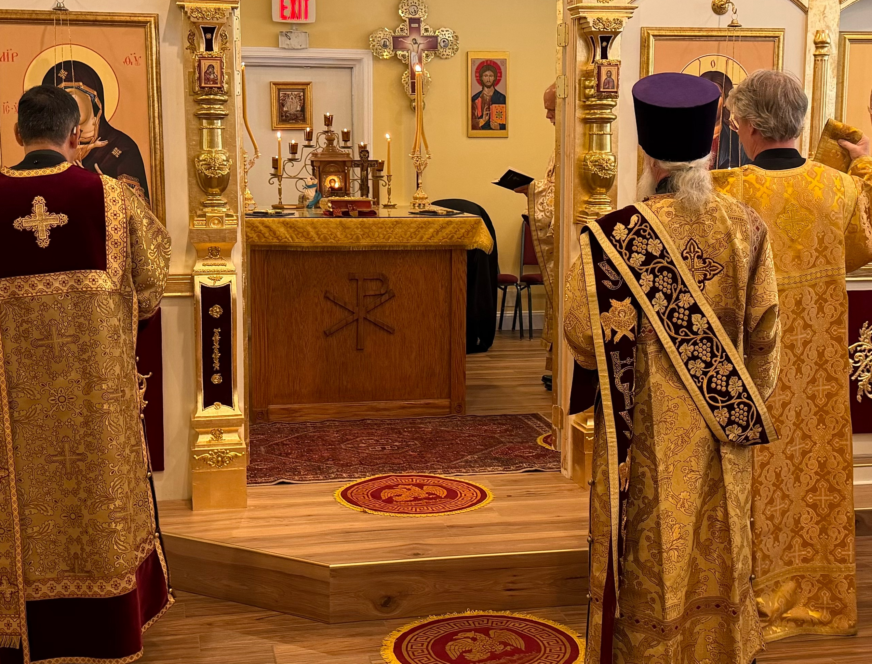
DIVINE LITURGY • CLASS 2
The Great Litany
Look at Who We Pray For
The Church
The world
Our bishop and clergy
Our country
Our community
Travelers
The sick
The suffering
Captives
Those in danger

Slide 17
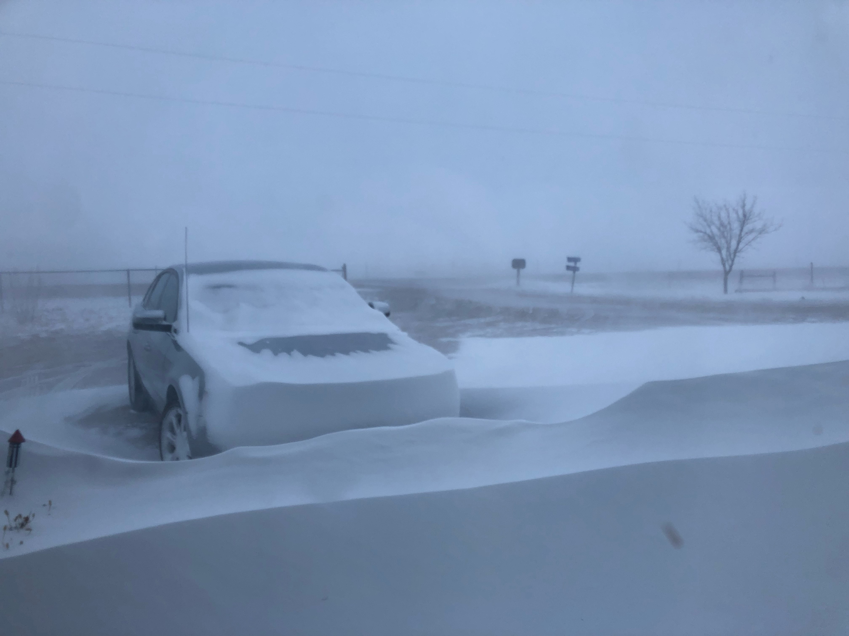
DIVINE LITURGY • CLASS 2
Even the Weather?
“For seasonable weather, abundance of the fruits of the earth, and peaceful times…”
Weather
Food
Travel
Health
Government
Community
Peace
Nothing is outside prayer.

Slide 18
DIVINE LITURGY • CLASS 2
Lord, Have Mercy
Lord. Have. Mercy. Lord. Have. Mercy.
Mercy
Compassion
Healing
Forgiveness
Protection
Help
Loving-kindness
Lord, your will be done.

Slide 19
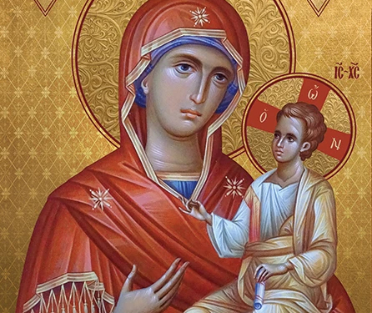
DIVINE LITURGY • CLASS 2
The Theotokos and All the Saints
“Commemorating our most holy, most pure, most blessed and glorious Lady Theotokos and ever-virgin Mary, with all the saints…”
This is where the earthly and heavenly Church come together again.
We’ve prayed for the world, the Church, the living and suffering, and now we remember that we aren’t the whole Church standing in this room.
The Theotokos and saints aren’t absent from Christian worship.

Slide 20
DIVINE LITURGY • CLASS 2
All of Our Lives
“Let us commend ourselves and each other and all our life unto Christ our God.”
Ourselves.
Each other.
All our life.

Slide 21
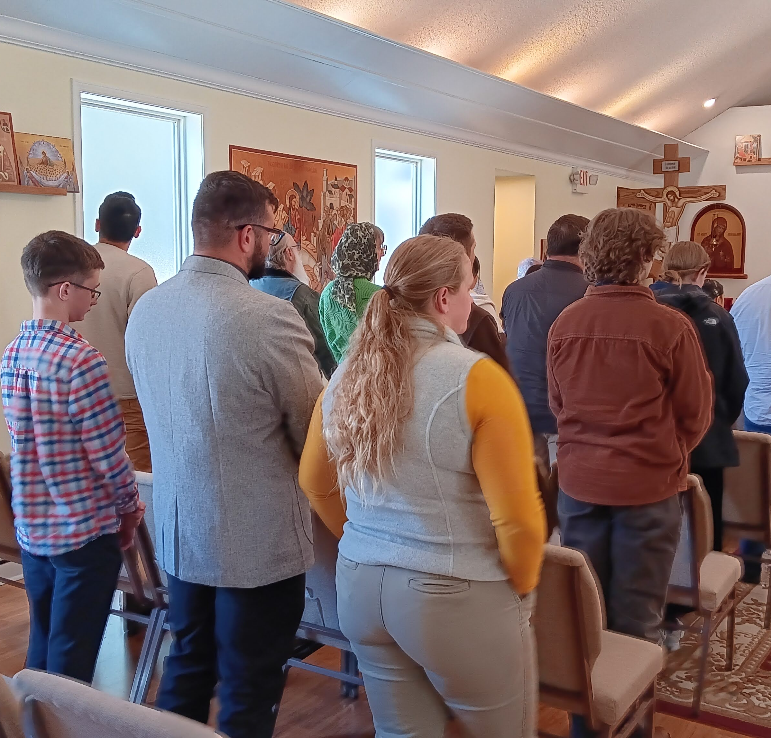
DIVINE LITURGY • CLASS 2
All of Our Lives
“Let us commend ourselves and each other and all our life unto Christ our God.”
S
What are we supposed to give Christ?
Ourselves.
Each other.
All our life.
Not Sunday morning.
Not our religious life.
All our life.
That’s the first few minutes of the Divine Liturgy.

Slide 22
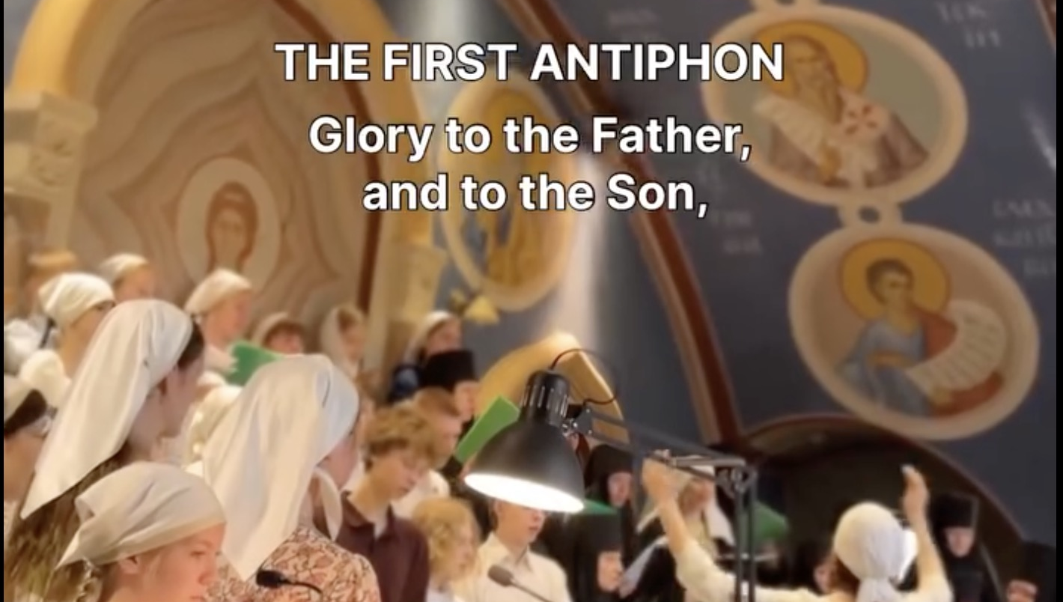
NEXT CLASS
The Antiphons and the Little Entrance

